Slide 1
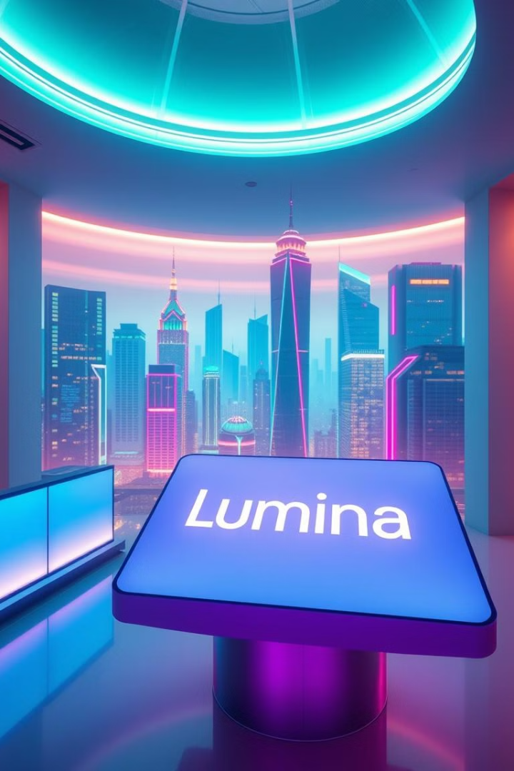
Introducing Lumina Digital: Illuminating the Future of Marketing
Our Philosophy: Fusing creativity and technology to create impactful digital experiences. Inspired by AKQA and Wieden+Kennedy, reimagined for a new era. Goal: To become a beacon of innovation in the digital marketing landscape.

Slide 2
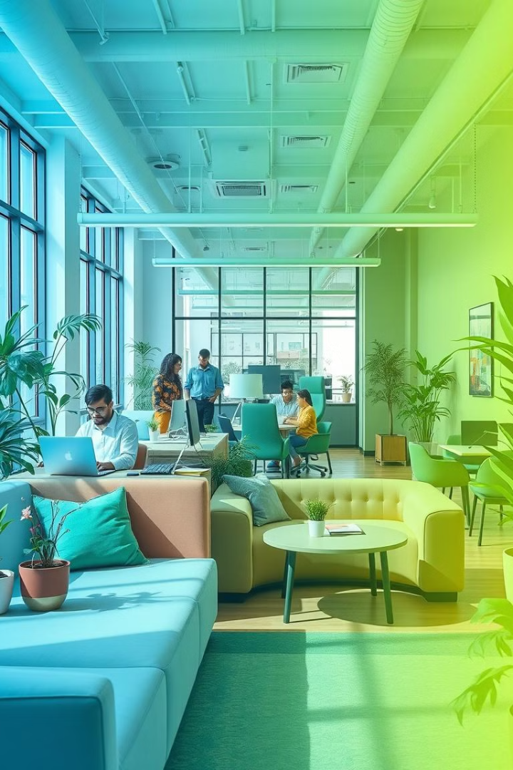
Work Policy: Empowering Our Team
Flexible Work Environment
Hybrid model with options for remote and in-office collaboration. Reference: Many agencies adopting hybrid to improve employee wellbeing and productivity by 20%.
Unlimited Vacation Policy
Encouraging rest and rejuvenation to foster creativity. Reference: Studies show rested employees are 12% more productive.

Slide 3

Work Policy: Empowering Our Team
Investment in Learning and Development
Mentorship Programs
Providing resources for continuous growth and skill enhancement. Reference: $1,500 annual education budget per employee.
Pairing experienced professionals with emerging talent. Reference: Mentored employees are promoted 5x more often.

Slide 4

Work Policy: Empowering Our Team
Wellness Initiatives
Prioritizing mental and physical health through various programs. Reference: 80% of workers have increased performance after Wellness Initiatives

Slide 5



Work Logic: The Lumina Process
Immersive Discovery
Strategic Ideation
Deep dive into client's business, audience, and goals. Example: Industry standard involves a 2-week discovery sprint.
Brainstorming innovative ideas and concepts, fostering a "no bad ideas" environment. Example: AKQA's rapid prototyping methodology.

Slide 6
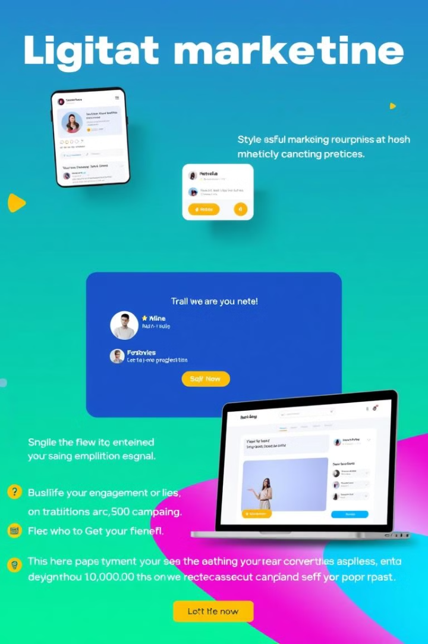


Work Logic: The Lumina Process
Creative Execution
Bringing ideas to life through compelling visuals, engaging content, and seamless user experiences. Example: Wieden+Kennedy's focus on quality and detail in production.
Data-Driven Optimization
Continuously monitoring performance, analyzing results, and refining strategies. Example: AKQA's real-time campaign optimization. Data: Marketing automation has increased by 22% in the last 3 years

